Slide 1
Diagnosing Cancer Using Deep-Learning Models
Supervised By
Dr. Manal Mohsen Tantawi
TA. Hadeer Elsaadawy
Member name | Department
El Bara Mohamed Mahmoud | Computer Science
Islam Hesham Hussein | Computer Science
Eslam Yahiya Abd El Aziz | Computer Science
Ahmed Magdy Ali | Computer Science
Islam Mohamed Zakaria | Computer Science

Slide 2
Agenda
Problem Definition
Project Motivation
Project Objective
Related Work
Proposed Methodology
Dataset
Results
Conclusion and Future Work
Demo
Tools
References

Slide 3
Problem Definition
In the past, there was no way to diagnose tumors resulting in many deaths.
As technology advances, X-rays have emerged, allowing scientists to speculate the presence of the tumor and act accordingly.
Neuroimaging: In the late 1940s, which outlined tumors at the time of surgery, and then tagged the fluorescein with radioactive iodine, which allowed visualization of the tumors before surgery
Until the emergence of MRI, which in turn led to the development of methods of treatment of patients and contribute to the medical field through computer-aided diagnosis(CAD).

Slide 4
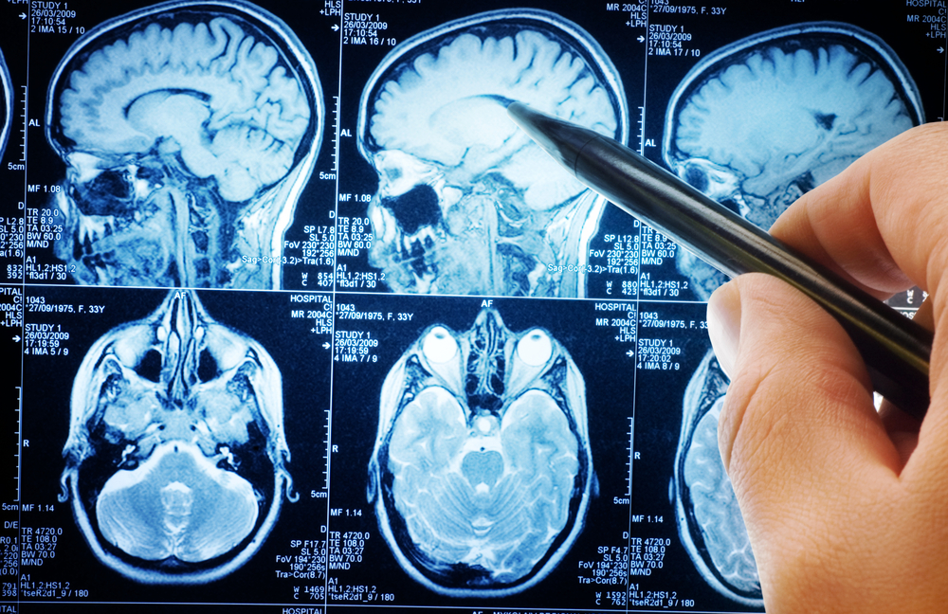
MRI Definition
Magnetic resonance imaging is a medical imaging technique that uses a magnetic filed and computer generated radio waves to create detailed images of the organs and tissues in your body.
MRI is the most frequently used imaging test of the brain often performed to help diagnose tumors , stroke and brain injury from trauma.

Slide 5
Agenda
Problem Definition
Project Motivation
Project Objective
Related Work
Proposed Methodology
Dataset
Results
Conclusion and Future Work
Demo
Tools
References

Slide 6
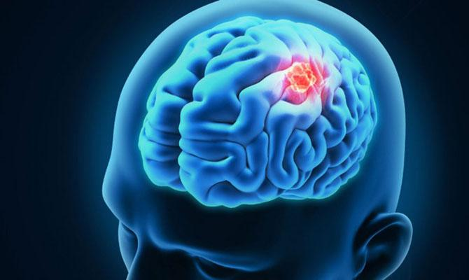
Motivation
Brain tumor detection is an important task in medical image processing. Early diagnosis of brain tumors plays an important role in improving treatment possibilities and increases the survival rate of the patients.
Due to the level of complexity in both the Human brain and the MRI Scanners there are many issues that may occur that increases the misdiagnoses of tumor.
Misdiagnosis occur due to technical reasons related to image quality resulting in human error.
(CAD) systems are developed to overcome these restrictions as it improves radiologists’ performance in discriminating between normal and abnormal tissues.

Slide 7
Agenda
Problem Definition
Project Motivation
Project Objectives
Related Work
Proposed Methodology
Dataset
Results
Conclusion and Future Work
Demo
Tools
References

Slide 8
Objectives
The Project aims to Implement the techniques of Deep learning for diagnosis tumors.
Deep learning implementation aims to provide an accurate diagnosis for brain tumor by processing (MRI) Scans
The Project is designed to be scalable and to be used for diagnosis of other malignant tumors

Slide 9
Agenda
Problem Definition
Project Motivation
Project Objective
Related Work
Proposed Methodology
Dataset
Results
Conclusion and Future Work
Demo
Tools
References

Slide 10
Related Work
References | Dataset | Preprocessing | Features & Classifiers | Accuracy
Isin et al. [1] (2016) | BRATS 2013 274 mri scan of patients with gliomas(both high and low grades) . 110 scans are available with unknown grades and unknown ground truths for testing. | Noise removal Skull-stripping Intensity base correction | Features :- Discrete wavelet transforms (DWT) Textons Multifractal Brownian motion First order statistical Raw intensities Local image textures Intensity gradients Edge based Classifiers :- NN SVM AdaBoost KNN SOM RFs CRF CC | 67%
Zacharaki et al. [2] (2017) | 98 patient(52 woman - 46 men) age (17 - 83) 4 had multiple tumors | Noise Reduction Inhomogeneity correction rigid intra subject registration using the public software (FSL) | Features :- forward selection method subset selection method Classifiers :- SVM RFs Leave-one-out | 98.2%
Sudha et al. [3] (2014) | 42 (25 abnormal 17 normal) testing data 30 (12 abnormal) | Noise removal Intensity base correction | Features :- FFNN MLP BPN Classifiers :- GLCM & GLRM AND Fuzzy Entropy Measure | 96%
Notes:
Future improvements and modifications in CNN architectures and addition of complementary information from other imaging modalities such as Positron Emission Tomography (PET), Magnetic Resonance Spectroscopy (MRS) and Diffusion Tensor Imaging (DTI) may improve the current methods.

Slide 11
References | Dataset | Preprocessing | Features & Classifiers | Accuracy
Roy et al. [4] (2019) | Whole Brain Atlas: MR brain image The EASI MRI Home. MR brain image | Dimension construction method Transform MRI into gray-scale using weighted summation of R,G,B components. | Classifiers :- K-means | 94.4%
Akkus et al. [5] (2017) | BRATS 2016 220 subjects with high grade and 54 subjects with low-grade for training. 53 subjects with mixed grades for testing | Registration skull-stripping intensity base correction Intensity Normalization noise removal | Classifiers :- DSC CNN SVM RFs CSF GM WM | 90%
Cheng et al. [6] (2015) | Brain tumor dataset 233 patient with 3064 image (708 meningioma’s – 1426 gliomas – 930 pituitary tumor). | Intensity normalization. | Features :- intensity histogram BoW GLCM Classifiers :- SVM SRC (1-3-715-45)NN | 91.14%
Thillaikkarasi et al. [7] (2018) | Small dataset | Smoothing using LoG CLAHE | Features :- SGLDM Classifiers :- SVM | 84%

Slide 12
References | Dataset | Preprocessing | Features & Classifiers | Accuracy
Zhao et al. [8] (2016) | BRATS 2013 35 patient. | intensity base correction Intensity Normalization | Classifiers :- FCNN CRF | 82%
Gubta et al. [9] (2015) | 78 MRI brain tumor | Morphological Opening Noise Removal gradient magnitude | Classifiers :- CNN HSV SVM Naive Bayes | 91.49%
Kaur et al. [10] (2014) | 70 MRI from local govt. hospital | image resizing Noise removal morphological operations like dilation and erosion | Classifiers :- Thresholding based methods Region growing based methods Neural network methods Fuzzy methods FVT | 99.59%
Seetha et al. [11] (2018) | BRATS 2015 80 MRI brain tumor | intensity base correction Intensity Normalization | Classifiers :- NN SVM KNN FCM DWT DNN LDA SMO | 97.5%
Kalapala et al. [12] (2015) | 1100 image slices (833 abnormal slices and 267 normal slices) of 150 abnormal patient volumes were considered in this work. | Normalization | Classifiers :- SVM LS | 98.92%

Slide 13
References | Dataset | Preprocessing | Deep-Learning Models | Accuracy
Ari et al. [13] (2018) | 16 patient : 9 patient used for training and 7 patient used for testing | Noise removal | CNN ELM ELM-LRF AlexNet | 97.18%
Banerjee et al. [14] (2018) | 285 patient : 210 hgg and 75 lgg | Noise Reduction | PatchNet SliceNet VolumeNet VggNet ResNet Anfc-IH NB LR MIP SVM CART KNN | 97.18%
Sobhaninia et al. [15] (2018) | 233 patient with 3064 image (708 meningioma’s – 1426 gliomas – 930 pituitary tumor). 900 for training and 200 for testing. | Intensity normalization. | LinkNet | 79%
Lin et al. [16] (2016) | BRATS 2015 (213)patient 18 has been removed because of incomplete or impropriate feature disclosure | Resize to 60*60 Intensity normalization. | LeNet-5 | (74 – 85 )%

Slide 14
References | Dataset | Preprocessing | Deep-Learning Models | Accuracy
Iqbal et al. [17] (2017) | 36 patient | Noise removal | SVM FFNN ELM EC | 91.17%
Zhang et al. [18] (2017) | 274 patient : 220 hgg and 54 lgg | Noise Reduction | VGG U-Net ResNet | 87%
Soltaninejad et al. [19] (2018) | BRATS 2017 46 patient 220 hgg and 75 lgg | Intensity normalization. | VGG | 86%

Slide 15
Related Work Analysis
We Concluded that :
Preprocessing techniques like noise removal and intensity normalization
Increases the accuracy
VGG, SVM and Res-Net Models could Achieve the Best Results

Slide 16
Agenda
Problem Definition
Project Motivation
Project Objective
Related Work
Proposed Methodology
Dataset
Results
Conclusion and Future Work
Demo
Tools
References

Slide 17
Preprocessing Steps:
Resizing
Noise removal using median filter
Intensity Normalization

Slide 18
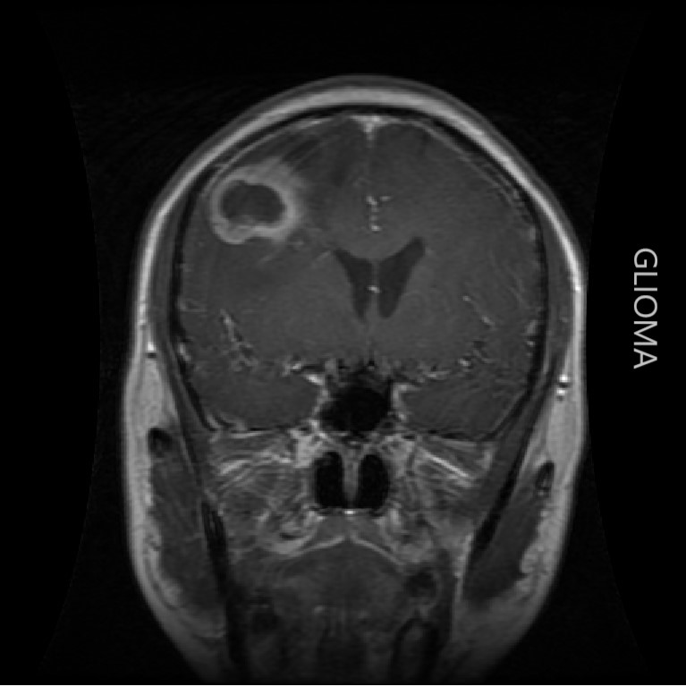

1-Resizing
Initially, All Images are Resized by 224x224
BEFORE Resizing
AFTER Resizing

Slide 19

2-noise removal using median filter
BEFORE Noise Removal
AFTER Noise Removal

Slide 20
3- Intensity normalization
BEFORE Normalization
AFTER Normalization

Slide 21
Classification:
We have utilized two different Approaches to compare the results and get the best one
First Approach: multi stage classification:
First stage: View Classification
Second stage : tumor Classification
Second Approach : single stage classification

Slide 22
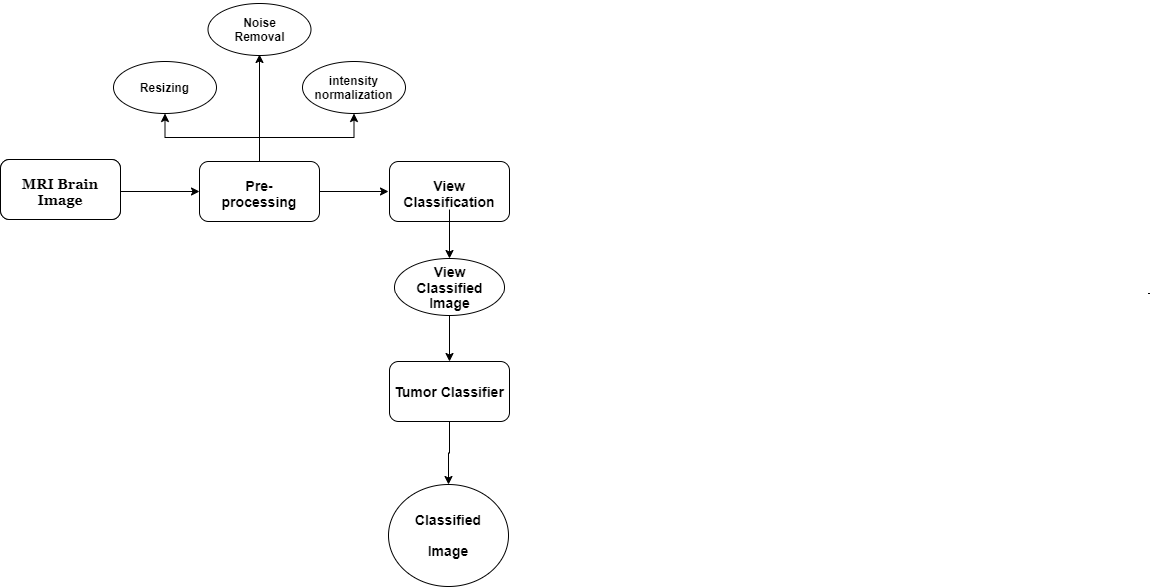
Multi stage Classification
1- View Classification:
The feature is extracted from the enhanced image The feature is selected from the extracted features based on the image view.
2-Tumor Classification:
After deciding the view of the image we use another model to classify if the image
is normal or abnormal then if it is abnormal the model decides what kind
of tumor found in the image.

Slide 23
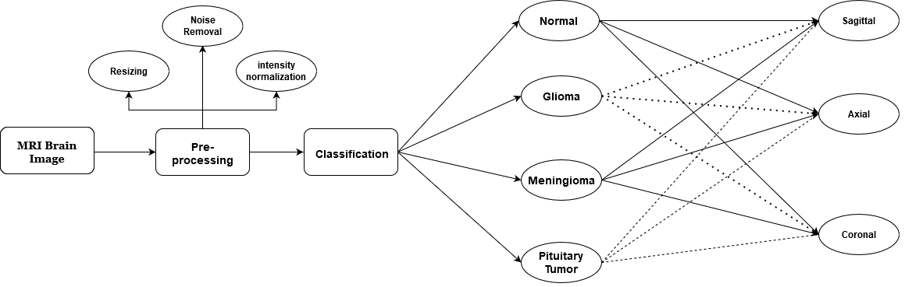
Single Stage Classification
The features are extracted from the enhanced image
The feature is selected from the extracted features based on the tumor features and image view.
Then, the selected feature can be given to the RES-NET classifier to classify the given image.

Slide 24
Classification Techniques:
Traditional Techniques:
Support Vector Machine (SVM)
Deep Learning Techniques :
VGG-16
VGG-19
Resnet50

Slide 25
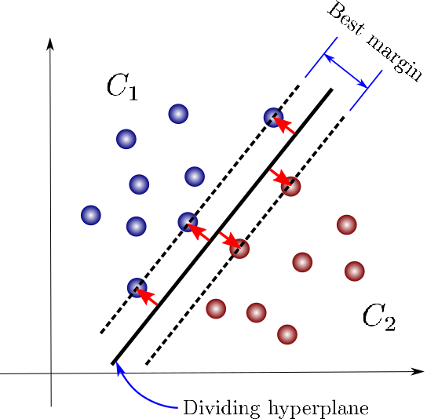
SVM
Traditional Technique :
SVM are supervised learning models with associated learning algorithms that analyze data.
Given a set of training examples, each marked as belonging to one or the other of two categories, an SVM training algorithm builds a model that assigns new examples to one category or the other
An SVM model is a representation of the examples as points in space, mapped so that the examples of the separate categories are divided by a clear gap that is as wide as possible. New examples are then mapped into that same space and predicted to belong to a category based on the side of the gap on which they fall.

Slide 26
VGG-16
Deep Learning Techniques :
The input to cov1 layer is of fixed size 224 x 224 RGB image. The image is passed through a stack of convolutional layers, where the filters were used with a very small receptive field: 3×3 .In one of the configurations, it also utilizes 1×1 convolution filter, which is a linear transformation of the input channels (followed by non-linearity). The convolution stride is 1 pixel.
Spatial pooling is carried out by five max-pooling layers, which follow some of the conv. layers (not all the conv. layers are followed by max-pooling). Max-pooling is performed over a 2×2-pixel window, with stride 2.
Three Fully-Connected (FC) layers follow a stack of convolutional .the first two have 4096 channels each, the third 1000 channels. The final layer is a soft-max layer to classify image into 1 of 12 classes .
All hidden layers are equipped with the rectification (ReLU) non-linearity.

Slide 27
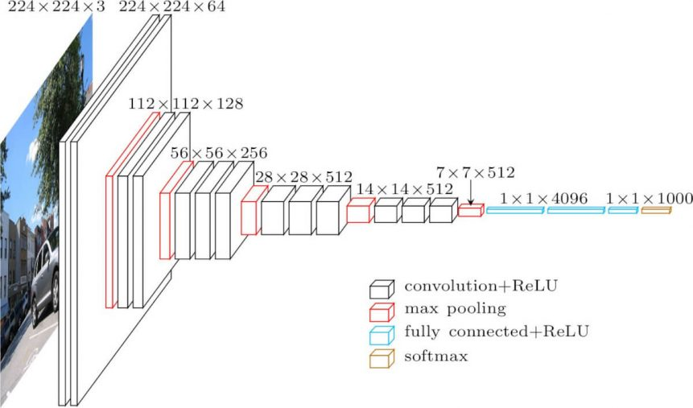

Slide 28
VGG-19
The number 19 stands for the number of layers with trainable weights. 16 Convolutional layers and 3 Fully Connected layers.
utilizes the Architectural style of:
[CONV-RELU-CONV-RELU-POOL]x16,[FC-RELU]x3,FC,SOFTMAX
UNTIL Fully Connected layer, ReLU, Dropout, Fully Connected, SoftMax, Classification output
Convolutions: is the functional operation of performing concatenation of Functional Curves
ReLU : Convolution is a linear operation. Therefore, we need a non-linearity.
Max Pooling: Pooling retains the most important information.
A Fully Connected Layer : is a traditional Multilayer Perceptron (MLP)
SoftMax act as a regularizer over a distribution

Slide 29
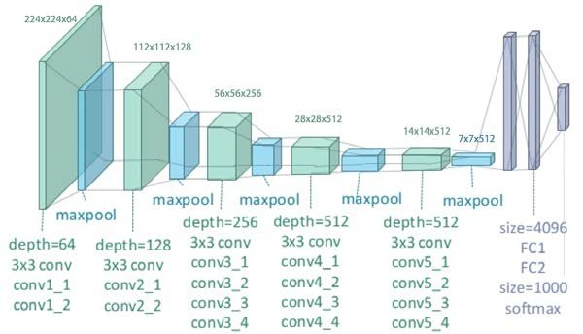

Slide 30
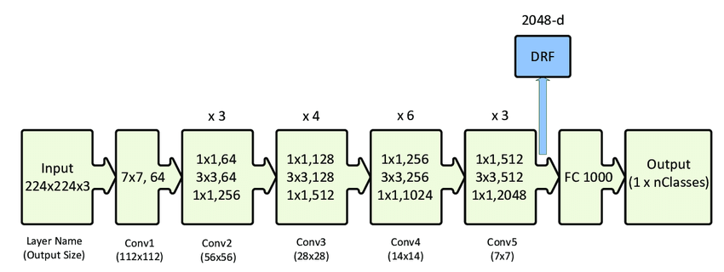
Resnet50

Slide 31
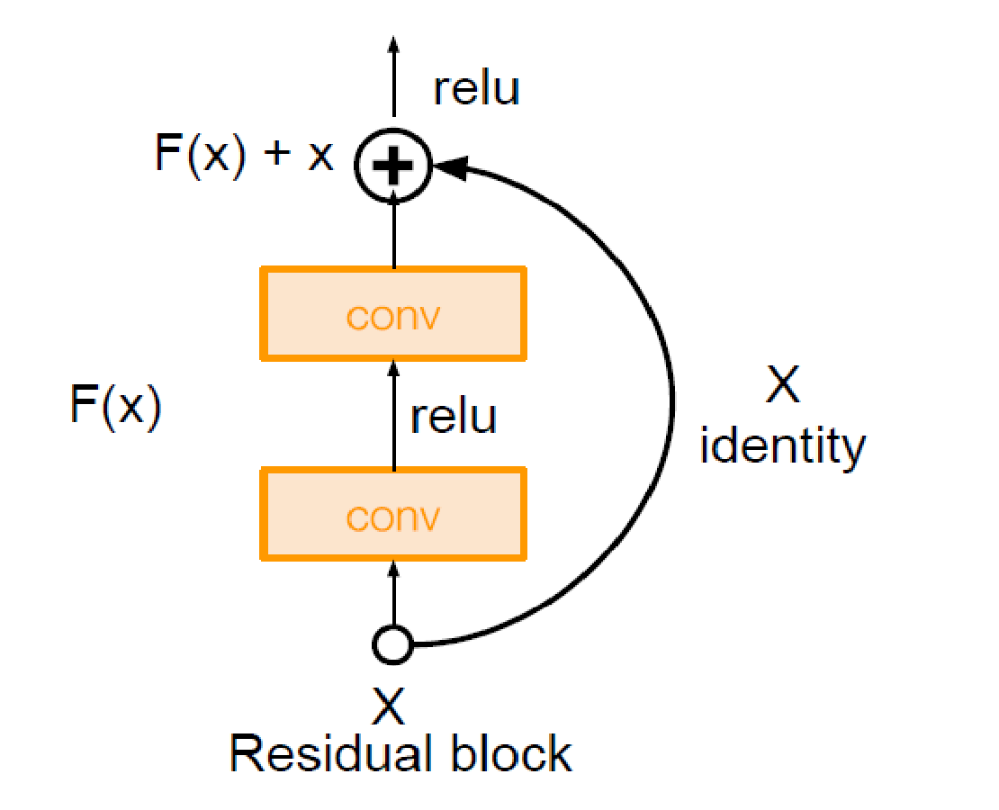
Full ResNet architecture:
-Stack residual blocks
-Every residual block has
two 3x3 conv layers
Batch Norm Layer
-Additional conv layer at
the beginning
-No FC layers at the end
(only FC 1000 to output
classes).

Slide 32
Agenda
Problem Definition
Project Motivation
Project Objective
Related Work
Proposed Methodology
Dataset
Results
Conclusion and Future Work
Demo
Tools
References

Slide 33
Dataset and sampling
To ensure accurate results , The Dataset is acquired from
Hospital
The dataset for brain tumor comprises of :
233 patient with 3064 image, classified as following
708 meningioma’s
1426 glioma’s
930 pituitary tumor
At the first we only have an abnormal dataset. the challenge we must get a normal dataset.
We start to search online in the first on Kaggle, google and a lot of searching sites but we did not find it.
After that we try to get it from an Egyptian hospital like (57357, alfa scan, techno scan) but for patient privacy they refused.
We are sending a lot of mail for an outside hospital until one of them respond with a dataset for a normal dataset and its software called mango

Slide 34
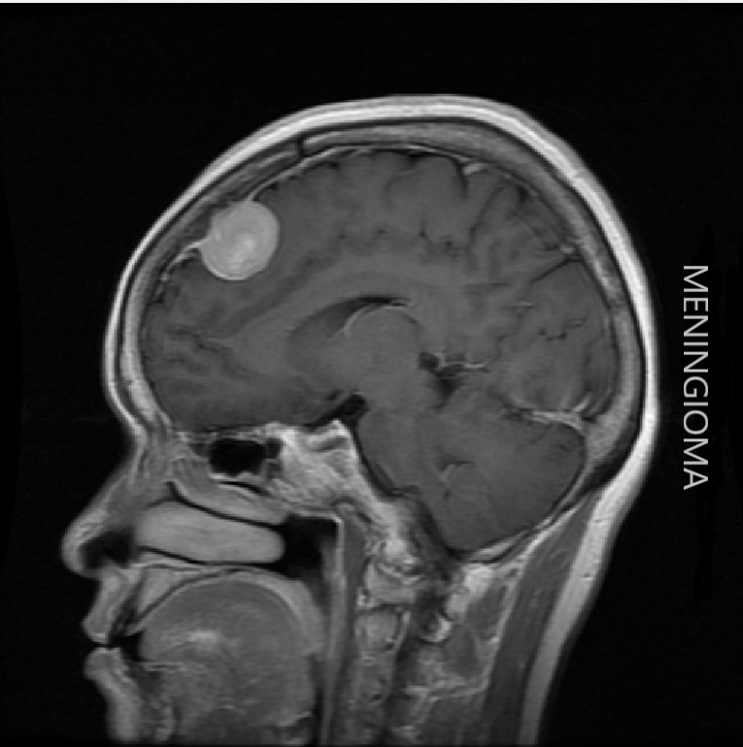

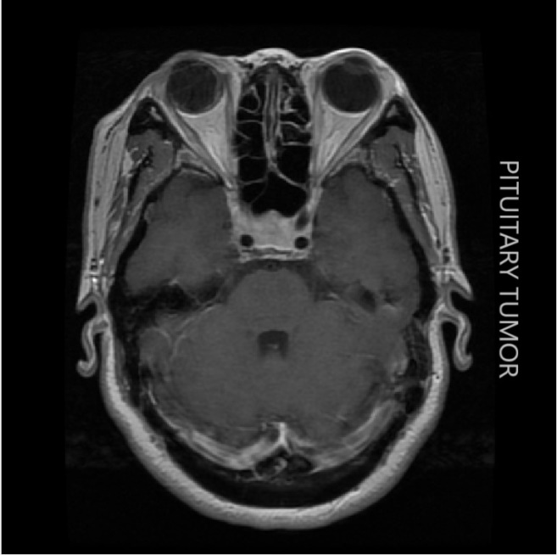
708 meningioma’s
1426 gliomas
930 pituitary tumor

Slide 35
Agenda
Problem Definition
Project Motivation
Project Objective
Related Work
Proposed Methodology
Dataset
Results
Conclusion and Future Work
Demo
Tools
References

Slide 36
Results
We used multiple CNN Architecture like VGG-16, VGG-19, Res-Net 50 and SVM. We started with SVM and after getting the best results we could got from it we tried VGG-16, VGG19, and Res-Net 50. The results we got from them was better than we got from SVM.
We tried 2 approaches:
1- Multi Stage Classification
2- Single Stage Classification

Slide 37
Multi-Stage Classification
First stage was designed for classifying views, second stage contains 4 classes designed for classifying tumor. We achieved total accuracy from 84% up to 94% and the best accuracy we got from Res-Net.

Slide 38
Single-Stage Classification
At Second approach we used single stage classification. We used 12 class each class consist of view (Axial, Coronal, Sagittal) and state of MRI (Normal, Glioma, Meningioma, Pituitary Tumor). We achieved total accuracy from 89% up to 95% from different trials on dataset (changing train and test) and the best accuracy we got from Res-Net.
After word we decided to be used Res-Net model as our model for implementing our project.
By trying some data augmentation techniques (Zoom, Rotate, Fill) and changing hyperparameters (optimizer, learning rate, epochs). We achieved accuracy up to 97%.

Slide 39
Traditional Techniques Results
SVM | 98% For Classifying Views
Deep Learning Techniques Results
ResNet-50 | 84% up to 2-stage classification
VGG-16 | 79% up to 84% on Abnormal
VGG-19 | 80% up to 85% on Abnormal
ResNet-50 | 97% On the Whole Data

Slide 40
Observations on the proposed Methodologies
After many trials of the proposed methodologies by changing hyper parameters, we found that the single stage method led to achieving slightly higher accuracy than that multi stage method.
Multi Stage Performance:
View Classification accuracy: 99%
tumor classification accuracy : 94%
Single Stage Accuracy:
Classification accuracy: 97%

Slide 41
Agenda
Problem Definition
Project Motivation
Project Objective
Related Work
Proposed Methodology
Dataset
Results
Conclusion and Future Work
Demo
Tools
References

Slide 42
Conclusion
In this project, the computer-based techniques for automatic classification of MR images as normal or abnormal using different classifier.
We worked on dataset we collected from multiple sources (Kaggle, some outside hospitals that respond to us).
We resized Images to 224x224 image resolution and tried training the models with RGB images. Then we normalized and removing noise using median filter for images because MR images are too sensitive for noise. Finally, we start our training. The performances of the classifiers in terms of statistical measures such as loss rate and accuracy are analyzed.
We trained some Deep Learning models like VGG-16, VGG-19 and Res-Net, and tried a machine learning method SVM. The results indicated that RES-Net approach yielded the better performance when compared to other classifiers as we achieved accuracy of 97% while other classifiers achieved accuracy ranged between 93% to 95%.
With each model we used we tried different hyper parameter like changing learning rate, optimizers and various numbers of epochs.
We used different data augmentation techniques to increase and balance our dataset to achieve higher accuracy

Slide 43
Future Work
We aim to try to increase the dataset to improve accuracy and we will get MR image for a breast cancer and lung cancer and more cancer types to add more functionality for our software like make a segmentation for MR image to know the exact cancer place. Also, trying to make a marketing for software and get a sponsor to be real world project.
Another aspect that may improve the performance is to involve more complicated image preprocessing procedures. MR images is susceptible to noise, so inhomogeneity correction and noise removal algorithms can be applied before feature extraction. Although we only use the simple min-max method to normalize intensity values, the experimental results are promising.

Slide 44
Agenda
Problem Definition
Project Motivation
Project Objective
Related Work
Proposed Methodology
Dataset
Results
Conclusion and Future Work
Demo
Tools
References

Slide 45
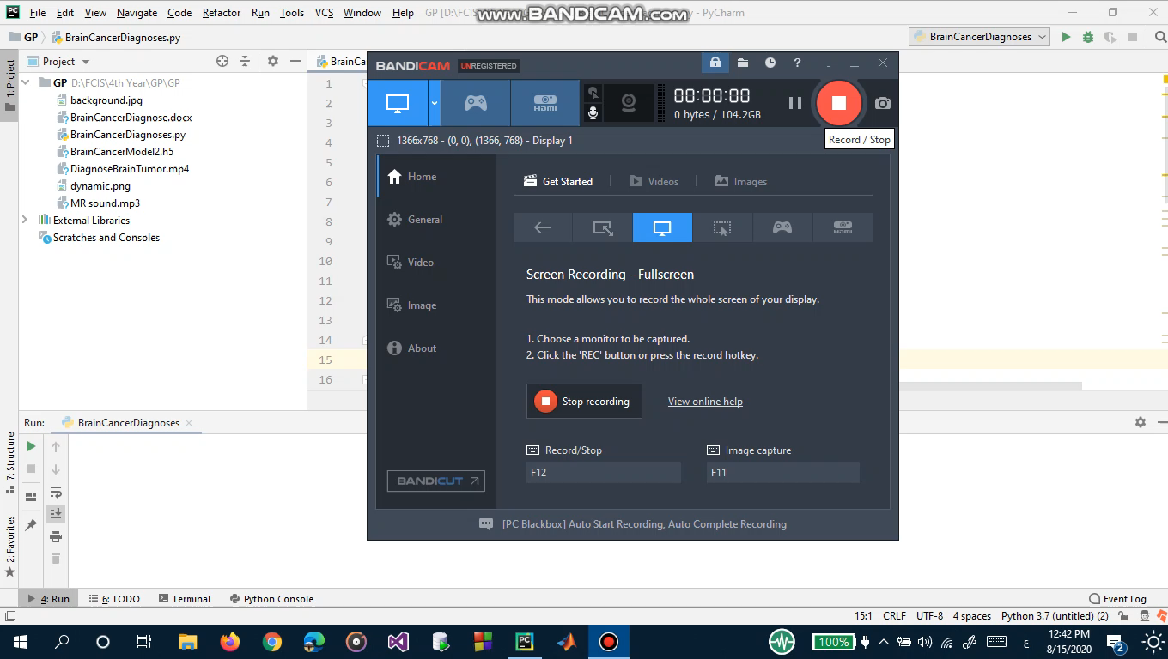
Demo for the system:

Slide 46
Tools
MATLAB
For preprocessing
Python
For Models Implementations and gui

Slide 47
References
Ali IúÕna, Cem Direkoglub, Melike ùahc. Review of MRI-based brain tumor image segmentation using deep learning methods. Procedia Computer Science( 2016).
Evangelia I. Zacharaki, Sumei Wang, Sanjeev Chawla, Dong Soo Yoo, Ronald Wolf, Elias R. Melhem, Christos Davatzikos. MRI-BASED CLASSIFICATION OF BRAIN TUMOR TYPE AND GRADE USING SVM-RFE. IEEE International Symposium on Biomedical Imaging(2014).
B.Sudha, P.Gopikannan, A.Shenbagarajan, C.Balasubramanian. Classification of Brain Tumor Grades using Neural Network. Proceedings of the World Congress on Engineering(2014).
Sudipta Roy a, Debnath Bhattacharyya, Samir Kumar Bandyopadhyay, Tai-Hoon Kim. Heterogeneity of human brain tumor with lesion identification, localization and analysis from MRI. Elsevier(2019).
Zeynettin Akkus, Alfiia Galimzianova, Assaf Hoogi, Daniel L. Rubin, Bradley J. Erickson. Deep Learning for Brain MRI Segmentation: State of the Art and Future Directions. J Digit Imaging (2017).
Jun Cheng, Wei Huang, Shuangliang Cao, Ru Yang, Wei Yang, Zhaoqiang Yun, Zhijian Wang, Qianjin Feng. Enhanced Performance of Brain Tumor Classification via Tumor Region Augmentation and Partition. PLoS ONE(2015).
R. Thillaikkarasi, S. Saravanan. An Enhancement of Deep Learning Algorithm for Brain Tumor Segmentation Using Kernel Based CNN with M-SVM. Journal of Medical Systems (2019).
Xiaomei Zhao, Yihong Wu, Guidong Song, Zhenye Li, Yong Fan and Yazhuo Zhang. Brain Tumor Segmentation Using a Fully Convolutional Neural Network with Conditional Random Fields. Chinese Academy of Sciences(2016).
Geetika Gupta, Rupinder Kaur, Arun Bansal, Munish Bansal. Analysis and Comparison of Brain Tumor Detection and Extraction Techniques from MRI Images. International Journal of Advanced Research in Electrical, Electronics and Instrumentation Engineering(2014).

Slide 48
Mandhir Kaur, Rinkesh Mittal. An Efficient Scheme for Brain Tumor Detection of MRI Brain Images Using Euclidean Distance With FVT. JOURNAL OF EMERGING TECHNOLOGIES IN WEB INTELLIGENCE(2014).
J. Seetha, S. Selvakumar Raja. Brain Tumor Classification Using Convolutional Neural Networks. Biomedical & Pharmacology Journal(2018).
Vidyasagar, Bhujangarao, Madhu. Qualitative Analysis of Brain tumor MRI. The International Daily journal(2015).
Ali ARI, Davut HANBAY. Deep learning based brain tumor classification and detection system. Turkish Journal of Electrical Engineering & Computer Sciences(2018).
Subhashis Banerjee, Sushmita Mitra. Brain Tumor Detection and Classification from Multi-Channel MRIs using Deep Learning and Transfer Learning. IEEE(2018).
Zahra Sobhaninia, Safiyeh Rezaei, Alireza Noroozi, Mehdi Ahmadi, Hamidreza Zarrabi, Nader Karimi, Ali Emami, Shadrokh Samavi. Brain Tumor Segmentation Using Deep Learning by Type Specific Sorting of Images. Department of Electrical and Computer Engineering(2018).
Yuehao Pan, Weimin Huang, Zhiping Lin, Wanzheng Zhu, Jiayin Zhou, Jocelyn Wong, Zhongxiang Ding. Brain Tumor Grading Based on Neural Networks and Convolutional Neural Networks. Society. IEEE Engineering in Medicine and Biology Society(2016).
Sajid Iqbal1, M. Usman Ghani, Tanzila Saba, Amjad Rehman. Brain tumor segmentation in multi-spectral MRI using convolutional neural networks (CNN). EMS Microscopy Acadmy(2018).
Jiachi Zhang, Xiaolei Shen, Tianqi Zhuo, Hong Zhou. Brain Tumor Segmentation Based on Refined Fully Convolutional Neural Networks with A Hierarchical Dice Loss. Key Laboratory for Biomedical Engineering(2017).
Mohammadreza Soltaninejad, Lei Zhang, Tryphon Lambrou, Guang Yang, Nigel Allinson, and Xujiong Ye. MRI Brain Tumor Segmentation using Random Forests and Fully Convolutional Networks. MICCAI(2017).
Parasuraman Kumar, B. VijayKumar. Brain Tumor MRI Segmentation and Classification Using Ensemble Classifier. International Journal of Recent Technology and Engineering(2019).

Slide 49
Any Questions ?!

Slide 50
THANK YOU

